Slide 1
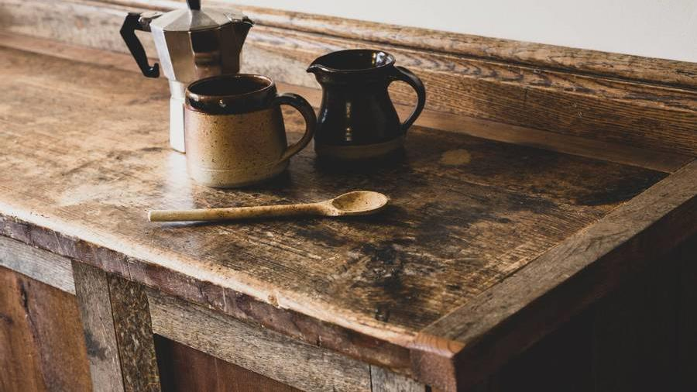
BILLING SYSTEM FOR CAFETERIA

Slide 2
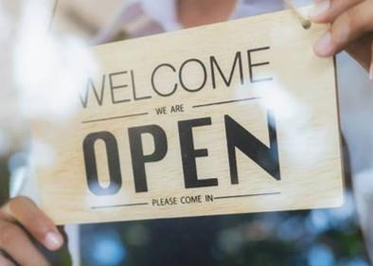

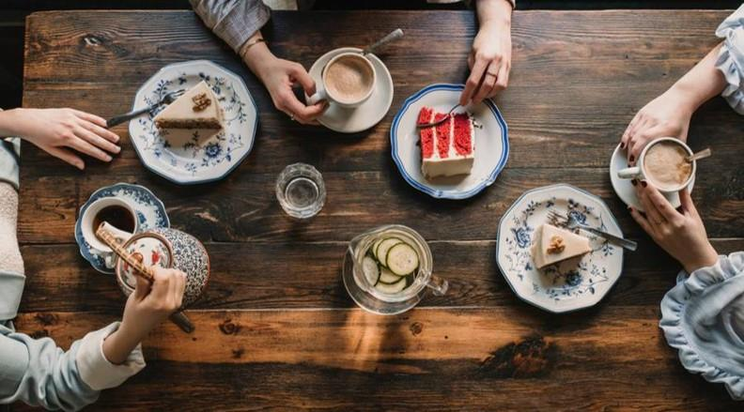
CONTENTS
ABSTRACT
PROBLEM DOMAIN
PROCEDURE
ADVANTAGES
CODING
RESULTS

Slide 3
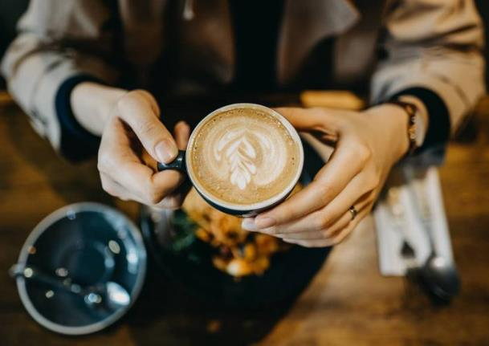
ABSTRACT
To use C or Python to make a Cafeteria billing program.

Slide 4
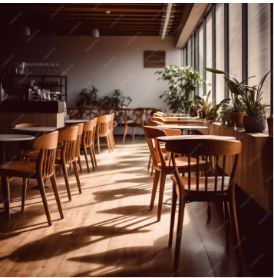
PROBLEM DOMAIN
• To understand how computational systems work in restaurants, hotels, and other recreational institutions.
• To understand basics of C programming language.
• To understand I/O statements in C.
• To understand use of variables in C.
• To understand switch() statements in C.

Slide 5
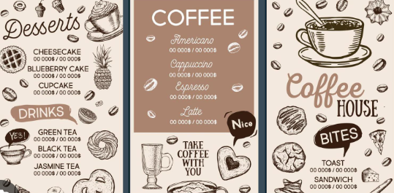
PROCEDURE
Print restaurant menu items each with a distinct menu number. For example: 1. Coffee, 2. Tea, etc.
2. Get desired menu item number through a scanf() function.
3. Create a swtich() statement in order to add individual costs for each menu item number to the total bill amount.
4. Print the total bill amount

Slide 6
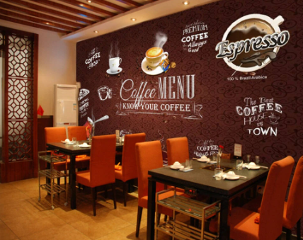
ADVANTAGES
• Easy to generate invoices, account statements.
• No manual errors can be created.
• The routine task of addition is now automated.
• Greater accuracy in calculations in now produced.

Slide 7
CODING
#include <stdio.h>
int main()
{
int a, qty, rate, total;
printf("\nMENU CARD \nSelect your drink \n1.COFFEE \n2.TEA\n3.COLD COFFEE \n4.MILK SHAKE \n5.STALC\n");
scanf("%d", &a);
switch(a)
{
case 1:
printf("\nYou have selected Coffee.\n Enter the quantity :");
scanf("%d", &qty);
rate = 5;
total = qty * rate;
printf("\nTotal amount :%d", total);
break;
case 2:
printf("\nYou have selected Tea.\n Enter the quantity :");
scanf("%d", &qty);
rate = 10;
total = qty * rate;
printf("\nTotal amount :%d", total);

Slide 8
break;
case 4:
printf("\nYou have selected Milk shake.\n Enter the quantity :");
scanf("%d", &qty);
rate = 20;
total = qty * rate;
printf("\nTotal amount :%d",total);
break;
case 5:
printf("\nYou have selected Stalc.\n Enter the quantity :");
scanf("%d", &qty);
rate = 15;
total = qty * rate;
printf("\nTotal amount :%d", total);
break;
default:
printf("\nSorry Unavailable...%ds", a);
break;
}
return 0;
}

Slide 9
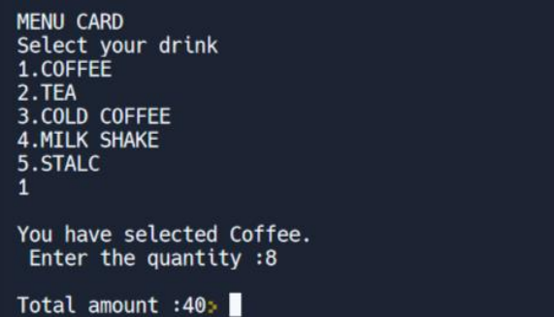
RESULTS

Slide 10
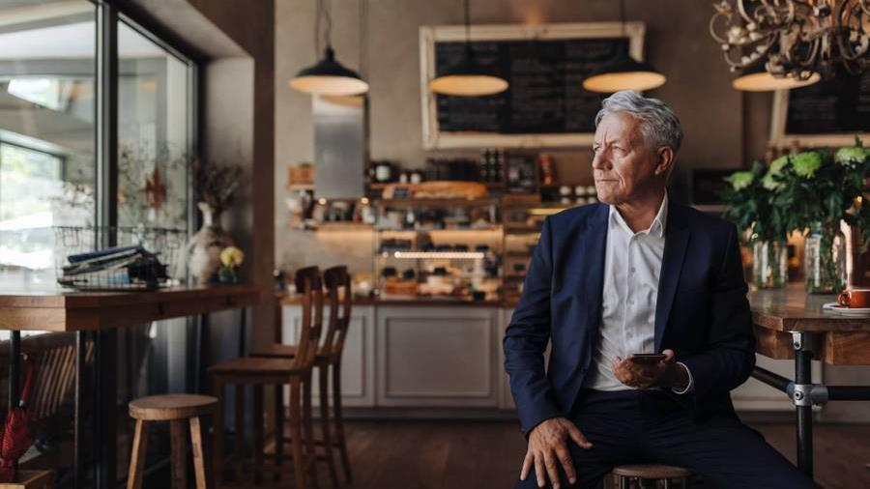
Thank you
K JOSHITHA- RA2312701010003
SHURUTHI- RA2312701010005

